Slide 1
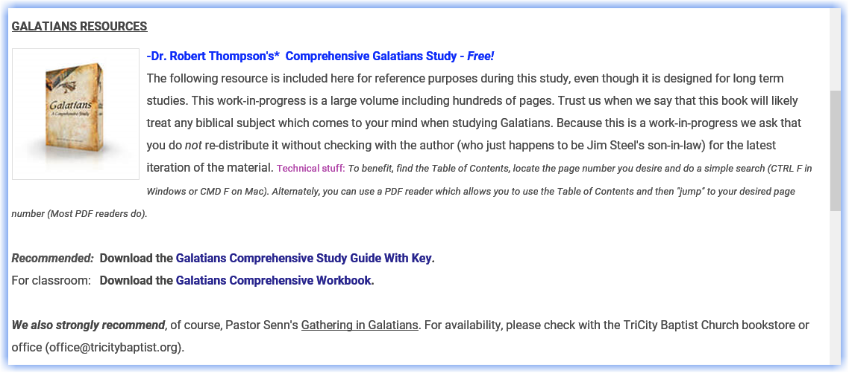

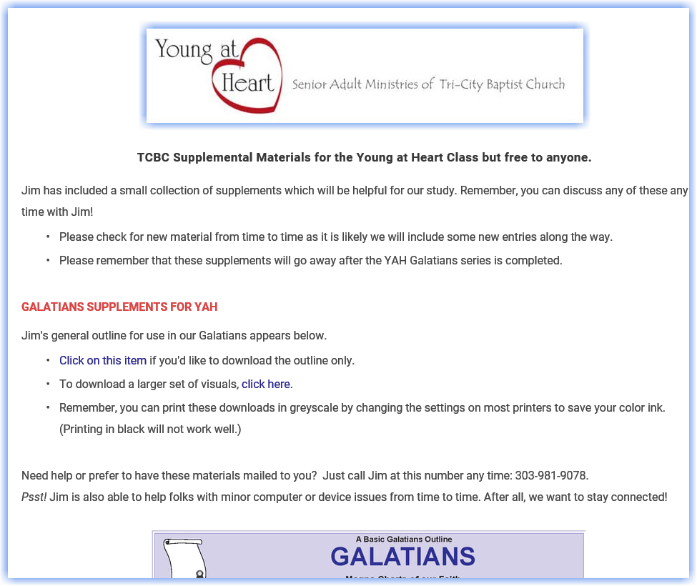
For ongoing materials, visit us at:
StandingTrue.com
(InternetBibleFellowship)
Click on the YAH image or select Recent Studies.

Slide 2
Welcome to GALATIANS
Six power packed chapters.
In Chapters 1 & 2
CHRIST’S GOSPEL IS GENUINE!
In Chapters 3 & 4
CHRIST’S GOSPEL IS SUPERIOR!
In Chapters 5 & 6
CHRIST’S GOSPEL IS LIBERATING!
The Gospel is Genuine as to its Nature
Chapter 2
The Gospel Is Superior In 0 the Privileges it Offers
Chapter 4
Christ’s Love
Ends Flesh Bondage
Chapter 6
The Gospel Is Genuine
as to its Origin
Chapter 1
The Gospel Is Superior in
the New Relationship it Creates
Chapter 3
Christ’s Love
Ends Law Bondage
Chapter 5
DESIGN Timeline RIBBON

Slide 3

Today’s Focus Area
Today’s Goal:
We want to finish chapter one next week, but first, we want to drill a bit deeper on a few important words and phrases.
We’ll ask four questions today as we interact with these verses.
(Matthew 4:4)
Don’t be weary in well-digging!

Slide 4
So where is Galatia?
Click any of the text to change out for your own. Some reformatting and stretching may be necessary in order to fill the gaps.
1 Paul, an apostle, (not of men, neither by man, but by Jesus Christ, and God the Father, who raised him from the dead;) 2 And all the brethren which are with me, unto the churches of Galatia: 3 Grace be to you and peace from God the Father, and from our Lord Jesus Christ, 4 Who gave himself for our sins, that he might deliver us from this present evil world, according to the will of God and our Father:
Question # 1
For Class Discussion

Slide 5


• Galatia is under the Red Arrow.
Where do we find GALATIA?
• Galatia can be seen in two ways: the first is the ethnic region (in the northern portion of the province) settled by the Gauls, and the second is the Roman province that included the cities and regions in the south of Antioch, Pisidia, Iconium, Lystra, Derbe.
In any case, Paul had a long history with these folks.
• Paul visited the Roman province of Galatia, located on the peninsula of Asia Minor, near the Mediterranean Sea, during his missionary journeys.

Slide 6
So, what’s the deal with the word “for?”
Click any of the text to change out for your own. Some reformatting and stretching may be necessary in order to fill the gaps.
1 Paul, an apostle, (not of men, neither by man, but by Jesus Christ, and God the Father, who raised him from the dead;) 2 And all the brethren which are with me, unto the churches of Galatia: 3 Grace be to you and peace from God the Father, and from our Lord Jesus Christ, 4 Who gave himself for our sins, that he might deliver us from this present evil world, according to the will of God and our Father:
Question # 2
For Class Discussion

Slide 7
BELIEVE IT OR NOT!
A SURPRISING NUMBER OF THE WORLD’S POPULATION HAS NO REAL PROBLEM
WITH THE IDEA THAT CHRIST DIED FOR THE SINS OF MEN.
HUH? YUP!
BUT ONLY A MINUTE NUMBER BELIEVE THAT CHRIST LITERALLY DIED
IN THEIR PLACE.
Click any of the text to change out for your own. Some reformatting and stretching may be necessary in order to fill the gaps.

Slide 8


Galatians 1:4
Focal POINT
POINT
We are talking about the biblical teaching called substitution.
Q. When Christ died for your sins, did He die on your behalf or did He die in your place?
A. Both! However, it is especially important to understand that the Greek word for “for” in this verse means Christ died IN YOUR PLACE!
PLEASE PROVE IT, JIM!

Slide 9
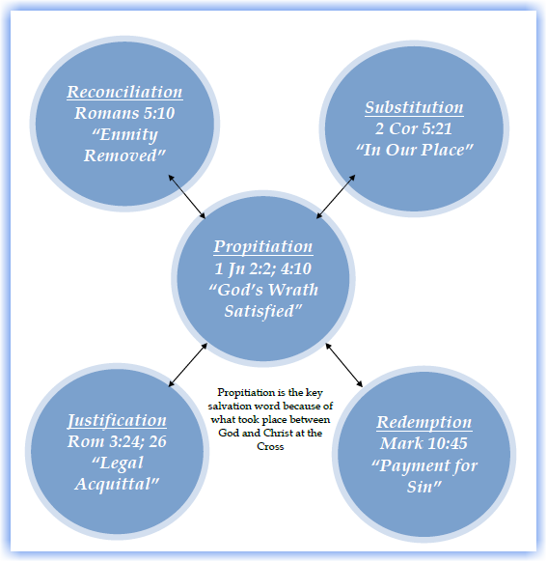

No Matter Where
We Search…
Look at any “salvation” word in your Bible…
When we begin searching out all the Bible’s words and terms which relate to our salvation, they all return to the same starting point.
They ALL connect back to the Old Testament sacrifices.
Those sacrifices ALL teach the same message: One day the LAMB OF GOD would come and die in our place! That’s substitution!
For tons of references see Thompson, Pages 29-32

Slide 10

You MUST BELIEVE Christ died in your place !
Compare 2 Corinthians 5:21 With verses such as Leviticus 4:24, John 1:29, 1 Peter 1:19
For he hath made him to be sin for us, who knew no sin; that we might be made the righteousness of God in him.
How substitution works:
God imputed our iniquity to the Lord Jesus Christ who, as the spotless lamb of God, became our sacrifice (that’s substitution). John 1:29
When we believe Christ, we are placed into Christ. 1 Cor. 12:2-13
As such we were crucified and raised again with Christ! Romans 6:1-11
That, dear friend, is the essence of salvation in a nutshell.

Slide 11
What about being “delivered?”
Now, the word salvation essentially connotes deliverance in its core meaning.
But wait, Paul intends us to sense even more when he uses the word for delivered in this verse!
1 Paul, an apostle, (not of men, neither by man, but by Jesus Christ, and God the Father, who raised him from the dead;) 2 And all the brethren which are with me, unto the churches of Galatia: 3 Grace be to you and peace from God the Father, and from our Lord Jesus Christ, 4 Who gave himself for our sins, that he might deliver us from this present evil world, according to the will of God and our Father:
Click any of the text to change out for your own. Some reformatting and stretching may be necessary in order to fill the gaps.
Question # 3
For Class Discussion

Slide 12
The original word for deliver in this verse is: exaireo.
It means to set free, to rescue, or deliver, but it also carries the idea of someone being seized out of something. This is full out rescue!
Now, there is some irony here. Why would someone who has been rescued want to return to bondage? Paul will be dealing with that in just a sec…
But first, look at the phrase:
What about being “delivered?” Continued
1 Paul, an apostle, (not of men, neither by man, but by Jesus Christ, and God the Father, who raised him from the dead;) 2 And all the brethren which are with me, unto the churches of Galatia: 3 Grace be to you and peace from God the Father, and from our Lord Jesus Christ, 4 Who gave himself for our sins, that he might deliver us from this present evil world, according to the will of God and our Father:
Click any of the text to change out for your own. Some reformatting and stretching may be necessary in order to fill the gaps.

Slide 13
What does it mean to be delivered from this present evil world ?
The word from is “ ek ” and means out of. The word world means eon or age.
The word evil here doesn’t just mean “bad”, it means perniciously and aggressively evil.
SO, HERE’S THE DEAL :
In the past, we were delivered or seized from this age when we were justified. (This passage)
In the present, we are being delivered or seized from Satan’s power in this evil age & culture which is under his growing control. So, don’t be a Demas! (Phil. 2:15,16, 2 Timothy 4:10)
In the future (maybe today) we will be delivered and seized up (harpazo) out of this present evil age at the rapture. (1 Thess. 4:17, Titus 2:12,13)

Slide 14
Galatians 1:6,7
NOW, WE HAVE ONE MORE MATTER.
POINT:
Focus POINT:
The Gospel

Slide 15
I marvel that ye are so soon removed from him that called you into the grace of Christ unto another gospel: Which is not another; but there be some that trouble you, and would pervert the gospel of Christ. Gal. 4:6,7
Click any of the text to change out for your own. Some reformatting and stretching may be necessary in order to fill the gaps.
When have we actually removed ourselves unto “another gospel?”
Question # 4
For Class Discussion

Slide 16

Inconvenient FACT # 1
Paul has already made the true gospel clear to these Galatians in his opening statements.
He has already spoken of Jesus Christ, His resurrection and His substitutionary sacrifice.
He has already told us that the Father purposed all of this.
The FACTS of the Gospel as we know it and confess it today were not in question among the Galatians.
THE GOSPEL MESSAGE CAN BE PERVERTED!
6. I marvel that ye are so soon removed from him that called you into the grace of Christ unto another gospel:
HETEROS
Another of a different kind.
7. Which is not another; but there be some that trouble you, and would pervert the gospel of Christ.
ALLOS
Another of the same kind.
This may be another gospel, but it is not the same kind!
Folks! If it is a different kind of gospel it is not the true gospel!

Slide 17
Inconvenient FACT # 2
GOSPEL PERVERTERS REMOVE THEMSELVES FROM GOD
For the time is come that judgment must begin at the house of God: and if it first begin at us, what shall the end be of them that obey not the gospel of God? And if the righteous scarcely be saved, where shall the ungodly and the sinner appear? 1 Peter 4:17,18
6. I marvel that ye are so soon removed from him that called you into the grace of Christ unto another gospel:
  So, who exactly were these guys? We know they were judaizers in general, but:
  Were these true Christians who departed from grace?
  Were these apostates who had merely come up to the gospel before rejecting it?
Paul does not even address that question here. He simply says we are to treat anyone who perverts the gospel of Christ as being accursed! Period!

Slide 18
Inconvenient FACT # 3
For the time is come that judgment must begin at the house of God: and if it first begin at us, what shall the end be of them that obey not the gospel of God? And if the righteous scarcely be saved, where shall the ungodly and the sinner appear? 1 Peter 4:17,18
WE PERVERT THE GOSPEL WHEN WE ADD TO OR REDUCE ITS REQUIREMENTS. PERIOD!
Remember! No one in Galatia had disputed the facts of the gospel.
Millions around us agree with the facts of the gospel but they have perverted it by adding their own requirements.
Example: When Augustine made sacramental participation and membership in the mother church a requirement for the gospel he perverted it.
Example: When we mix the gospel of grace with the gospel of the Kingdom, we create another gospel of a different kind.
When your friends add any requirement or work to the gospel, they are no longer your friends. They are beloved enemies.

Slide 19
Inconvenient FACT # 4
For the time is come that judgment must begin at the house of God: and if it first begin at us, what shall the end be of them that obey not the gospel of God? And if the righteous scarcely be saved, where shall the ungodly and the sinner appear? 1 Peter 4:17,18
EVANGELICALS WHO ARE SOMETIMES WILLING TO NAME DISTANT CULTISTS…
REMAIN STRANGELY SILENT AND UNWILLING TO NAME THEIR OWN WHO PERVERT THE GOSPEL.
Are your young people today who are flocking to a host of popular teachers and leaders who are perverting the clear gospel of Jesus Christ…worth the risk??
It is not enough to teach principles of discernment. It is wrong and sinful not to name and treat as accursed those who pervert the clear gospel of Jesus Christ.
Are we living in a glass house?

Slide 20
Here’s Just One
Example…
Prove Us Wrong!
When we begin searching out all the Bible’s words and terms which relate to our salvation, they all begin with the same starting point.
They ALL connect back to the Old Testament sacrifices.
Those sacrifices ALL teach the same message: One day the LAMB OF GOD would come and die in our place!

Slide 21

So, Did You Pay Attention in Class?
School’s Out!
Where is Galatia? Jim thinks Paul’s multiple contacts with the Galatians were probably in the southern Roman province.
Why is the word “for” important in verse 4? It teaches us the underlying principle of salvation – substitution. Christ died in our place, not just for us!
What does it mean to be delivered from this present evil age? In the past it speaks to our rescue from sin, our justification. In the present it speaks to our divine protection as we endure this age. In the future we will be seized up and raptured from this evil age. Brace yourself!!
When and how do we actually remove ourselves from the gospel? Any time we add requirements to it or take away from it. When we do this we are teaching a different kind of gospel and we are seen as accursed.

Slide 22
End of Session 1
July 26,2020

